Slide 1
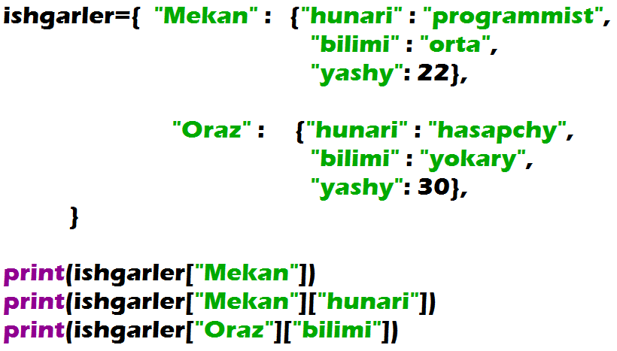

Nested Dictionaries

Slide 2
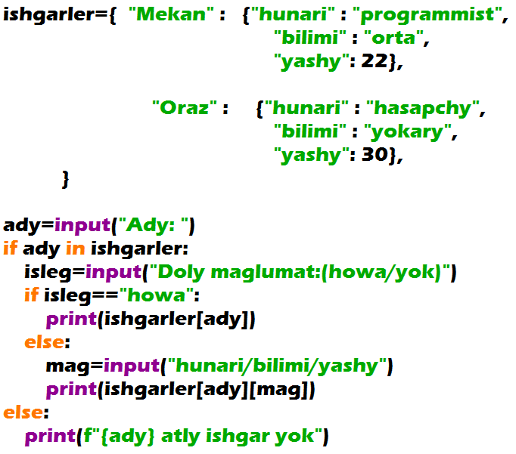

Nested Dictionaries

